Slide 1
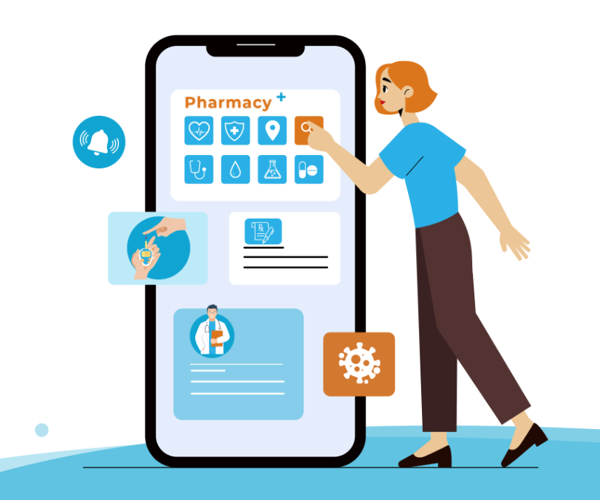
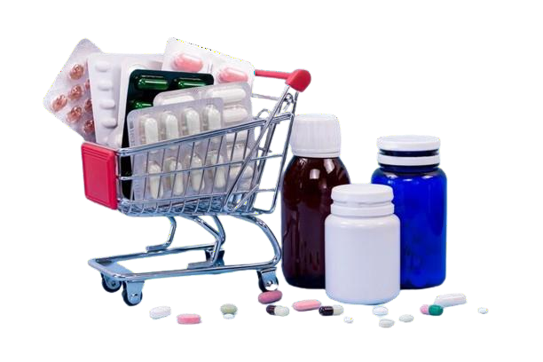
Launch Plan for Pharma Revive App
Presented by:
Aakarsh Shirley Iris

Slide 2
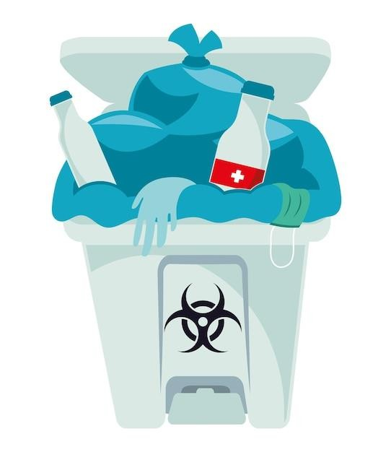
Introduction:
Overview
Purpose
Welcome to the launch plan presentation for the expansion of the MediReuse initiative through the integration of a mobile application.
This presentation aims to provide a comprehensive overview of our initiative, outlining key features, profit distribution strategy, legal considerations, challenges, and implementation plan.

Slide 3
Integration of Mobile Application:
Functionality for Consumers:
Consumers can easily register and list their unused medications.
Convenient scheduling of pick-ups from their homes.
In-app guidance ensures safe packaging of medications.
Estimate redemption value of listed medications.
Push notifications keep consumers informed about pick-up schedules and redistribution updates.
Functionality for Retail Pharmacies and Manufacturers:
Backend portal facilitates efficient inventory management for pharmacies.
Manufacturers can track received medications and repackaging updates through the system.

Slide 4
Logistics Support:
Real-time tracking of medicine collections.
Optimized route planner for pick-up agents.
Digital records maintain transparency throughout the medication lifecycle.
Quality Assurance and Regulation:
Utilization of blockchain for immutable records of drug authentication and redistribution.
Educational section within the app highlights safe medicine reuse practices and environmental impact.
User Engagement and Incentives:
Incorporation of gamification elements to promote user engagement.
Points, badges, and discounts offered as incentives for participation.

Slide 5
Feedback Collection and Data Sharing:
Feedback to Users:
Users will have the opportunity to provide feedback on their experience with the reused medications.
Feedback mechanisms will ensure continuous improvement and accountability.
Data Sharing with Manufacturers:
Feedback data will be shared with manufacturers to assess the quality and effectiveness of the reused medicines.
Manufacturers can use this data to make informed decisions about the acceptability of returned medications.
Analytics and Reporting:
Advanced data analytics track participation rates and environmental impact metrics.
Manufacturers can access reports for insights into medication reuse effectiveness.

Slide 6
Profit Distribution Strategy:
Redemption Value for Customers:
Customers receive 40-50% redemption value of the original cost of returned medicine.
Profit for Manufacturers:
Manufacturers benefit from cost reduction in raw materials, waste management, and operational efficiency.
Profit margin determined by analyzing savings and costs.
Revenue Streams and Cost Analysis:
Revenue from redemption fees, manufacturer reimbursements, and potential government subsidies.
Operational costs meticulously calculated for profit assessment.

Slide 7
Balancing Incentives and Sustainability:
Balance between attractive customer incentives and financial sustainability prioritized.
Manufacturers perceive financial advantage in receiving returned medications.
Dynamic Pricing Strategy:
Pricing adjusts based on market dynamics, demand-supply, and testing outcomes.

Slide 8
Implementation Plan And Considerations:
Research and Feasibility Study:
Market analysis and legal expertise sought to navigate regulatory framework.
Legal Considerations and Compliance:
Adherence to privacy laws and industry regulations ensured throughout the development process.
Business Plan Development:
Clear value proposition and rebate levels established to attract stakeholders.
Building Partnerships:
Key partnerships with pharmaceutical companies, pharmacies, and manufacturers established for mutual value creation.

Slide 9
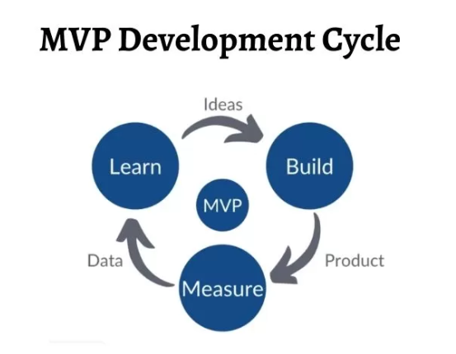
Blockchain Platform Development:
Selection of suitable blockchain framework and design of smart contracts for transparency.
Mobile Application Development:
Design and development of user-friendly consumer-facing and backend systems.
Financial Planning:
In-depth financial assessment conducted to ensure sustainability.
Prototype Testing & Quality Control:
MVP development and rigorous testing conducted to gather
feedback and ensure quality.
Funding and Financial Support:
Exploration of funding options such as investors, grants, and government incentives.
Marketing and User Acquisition:
Extensive awareness campaign and incentive programs developed to attract users.

Slide 10
Future Expansion:
Introduction of Medicine Sales:
Future plans include expanding the app to include the sale of both new and reused medications.
Users will have the option to purchase medications directly through the app, further promoting sustainable healthcare practices.

Slide 11
Challenges And Potential Solutions:
Regulatory Compliance:
Diligent adherence to regulatory standards and ongoing monitoring for compliance.
Consumer Trust:
Transparency and education initiatives to build trust among consumers.
Logistics Efficiency:
Continuous optimization of logistics processes to ensure timely pick-ups and deliveries.
Quality Control:
Rigorous testing and quality assurance measures to maintain medication quality.

Slide 12
Manufacturer and Pharmacy Engagement:
Regular communication and incentives to encourage participation.
Public Awareness:
Comprehensive awareness campaigns to educate the public about the benefits of medication reuse.
Financial Viability:
Dynamic pricing strategy and careful financial planning to ensure profitability.

Slide 13


